Slide 1

Simple and Principled Uncertainty Estimation with Deterministic Deep Learning via Distance Awareness
Nicolas Blumer
Advanced Topics in Machine Learning and Data Science 6.3.2024
Notes:
Google
2020

Slide 2
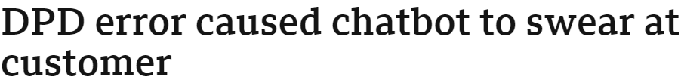

Uncertainty
Sources:
Measurement Errors
Modeling Assumptions
Random Variation
…
Epistemic Uncertainty: incomplete knowledge or information.
Aleatoric Uncertainty: Inherent variability in the system (irreducible)
Utility:
Notes:
Types of uncertainty not that relevant
Sources. Incomplete information

Slide 3

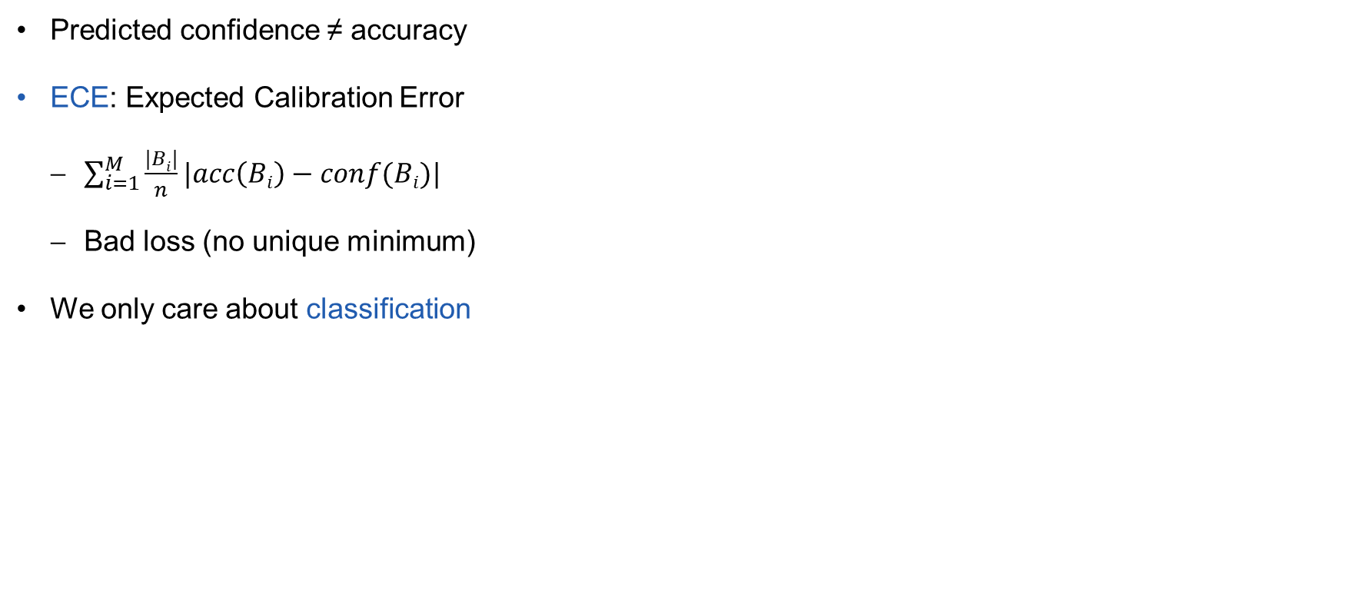
Calibration
Predicted confidence ≠ accuracy
ECE: Expected Calibration Error
$\sum_{i=1}^{M}{\frac{|Bi|}{n}|acc\left(Bi\right)−conf(Bi)|}$
Bad loss (no unique minimum)
We only care about classification
Notes:
Predict marginal probabilities

Slide 4
Uncertainty – One step
Deep learning approaches to estimate uncertainties usually involve ensembles
Just predict variance/uncertainty as additional output
Does not work well
Spectral-normalized Neural Gaussian Process (SNGP)
Notes:
3min
Serveral forward passes
«deterministic»

Slide 5
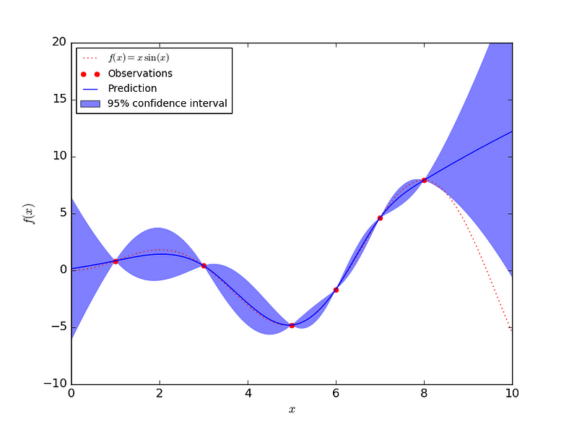
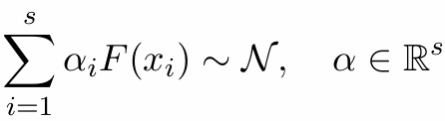
Gaussian Process
Notes:
4. Distance aware

Slide 6
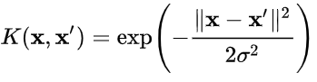
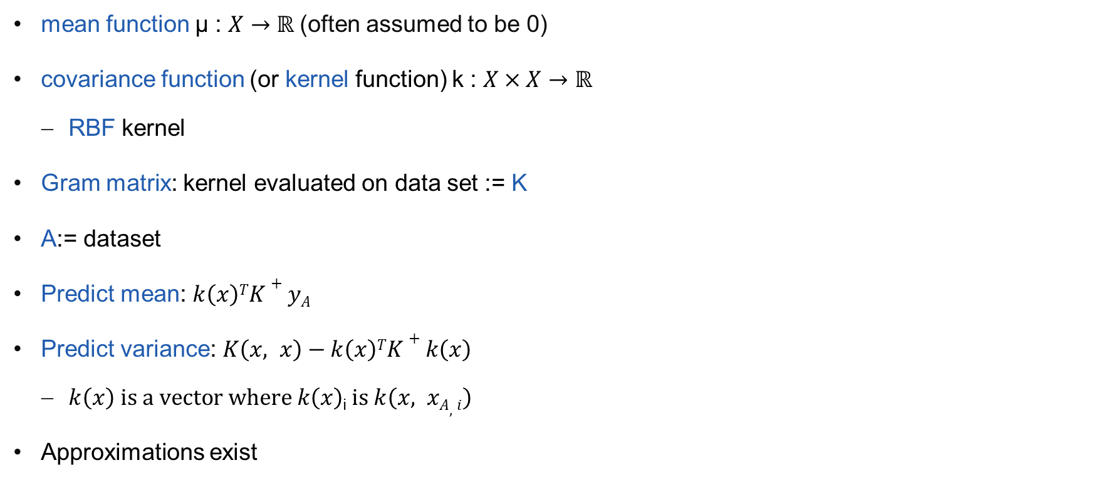
Gaussian Process
mean function µ : $X→ℝ$(often assumed to be 0)
covariance function (or kernel function) k : $X×X→ℝ$
RBF kernel
Gram matrix: kernel evaluated on data set := K
A:= dataset
Predict mean: $k\left(x\right)TK+yA$
Predict variance: $K\left(x, x\right)−k\left(x\right)TK+k\left(x\right)$
$k\left(x\right) is a vector where k\left(x\right)$_{i}$is k\left(x, xA,i\right)$
Approximations exist
Notes:
Radial basis function kernel
Assume mean is 0
the Gram matrix (or Gramian matrix, Gramian) of a set of vectors v_i.. in an inner product space is the Hermitian matrix of inner products, whose entries are given by the inner product G_ij=⟨v_i,v_j⟩
Sigma = sigma of noise
Inducing points…

Slide 7
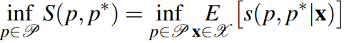
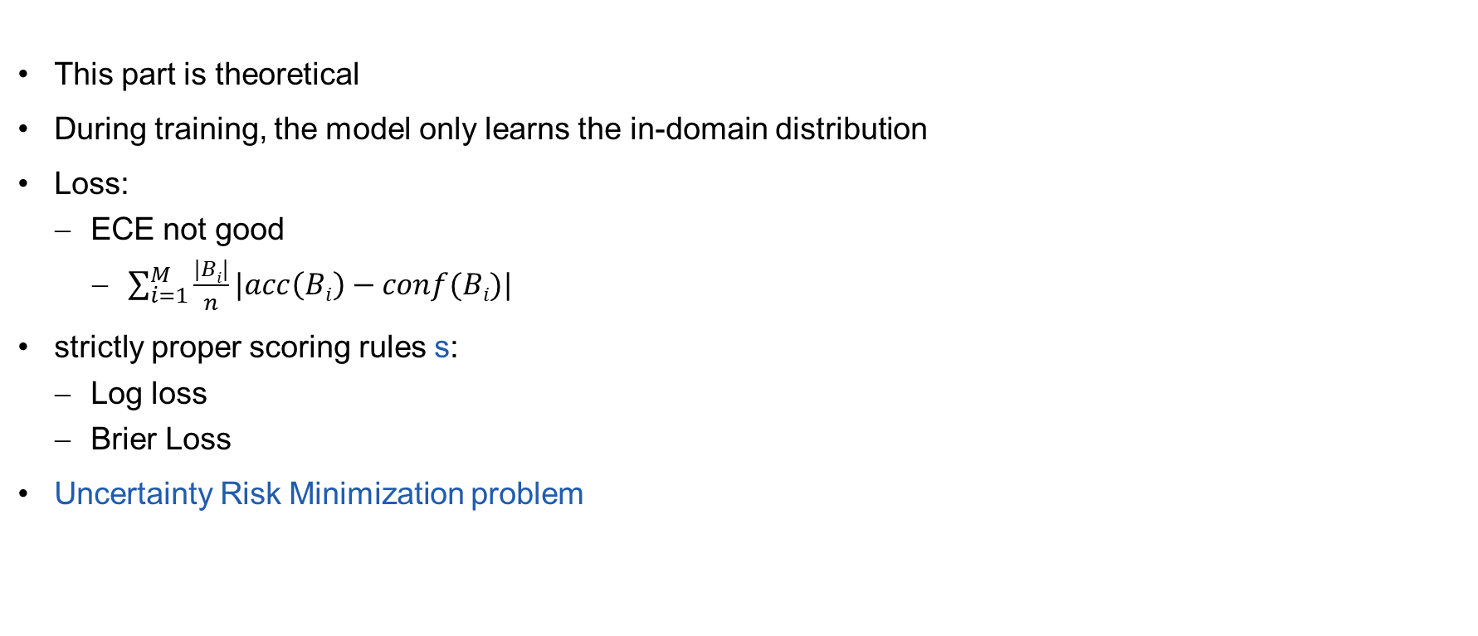
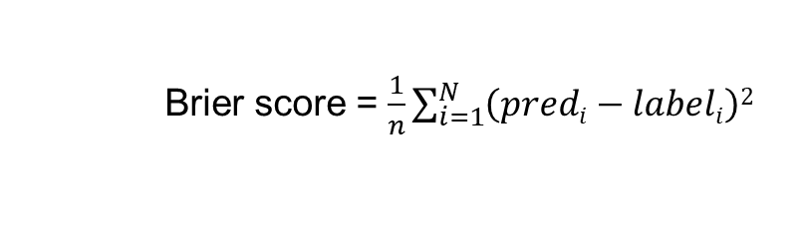
Uncertainty Estimation
This part is theoretical
During training, the model only learns the in-domain distribution
Loss:
ECE not good
$\sum_{i=1}^{M}{\frac{|Bi|}{n}|acc\left(Bi\right)−conf(Bi)|}$
strictly proper scoring rules s:
Log loss
Brier Loss
Uncertainty Risk Minimization problem
Brier score = $\frac{1}{n}\sum_{i=1}^{N}{\left(predi−labeli\right)2}$
Minimize loss over input space
Model Class
All possible inputs
Notes:
is an upper bound of the calibration error by the classic calibration-refinement decomposition→ minimizing a proper scoring rule implies minimizing the calibration error of the model

Slide 8
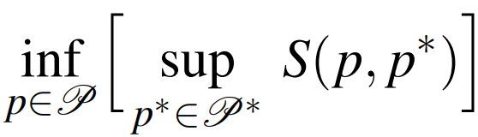
Uncertainty Estimation as a Minimax Learning Problem
minimize the Minimax Uncertainty Risk
Under the classification task and for Brier score, the solution to the minimax problem adopts a simple and elegant form:
In domain
Out of domain
Notes:
Bergman scores: class of asymmetric measures of the difference between two points in a convex space

Slide 9
Distance to Datapoints
Need to know if your input is close to the trainings data X_{IND}
Need distance awareness
Gaussian Process
GPs are inefficient
Notes:
10
assuming we know the true domain probability p ∗ (x ∈ XIND), and given a model p(y|x,x ∈ XIND) that we have already learned from data, what is the best solution we can construct to minimize the minimax objective
Not practical: highlight the theoretical necessity of taking into account the domain probability in constructing a good solution for uncertainty quantification
if an input point is in the training data domain, trust the model, otherwise use a uniform (maximum entropy) prediction

Slide 10
Spectral-normalized Neural Gaussian Process (SNGP)
Distance aware Neural Network
Replace last layer with Gaussian Process
Distance preserving hidden layers
Notes:
Each component of the feature map z(x) projects x onto a random direction ω drawn from the Fourier transform p(ω) of k(∆), and wraps this line onto the unit circle in R2
unbiased estimator of k(x, y).
Why project to circle: norms of the random vectors remain constant. the distance between the projected vectors (i.e., the angle between them) effectively approximates the distance between data points in the input space.

Slide 11
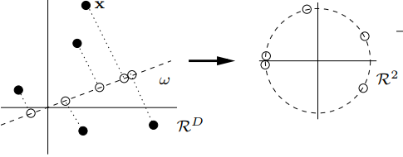
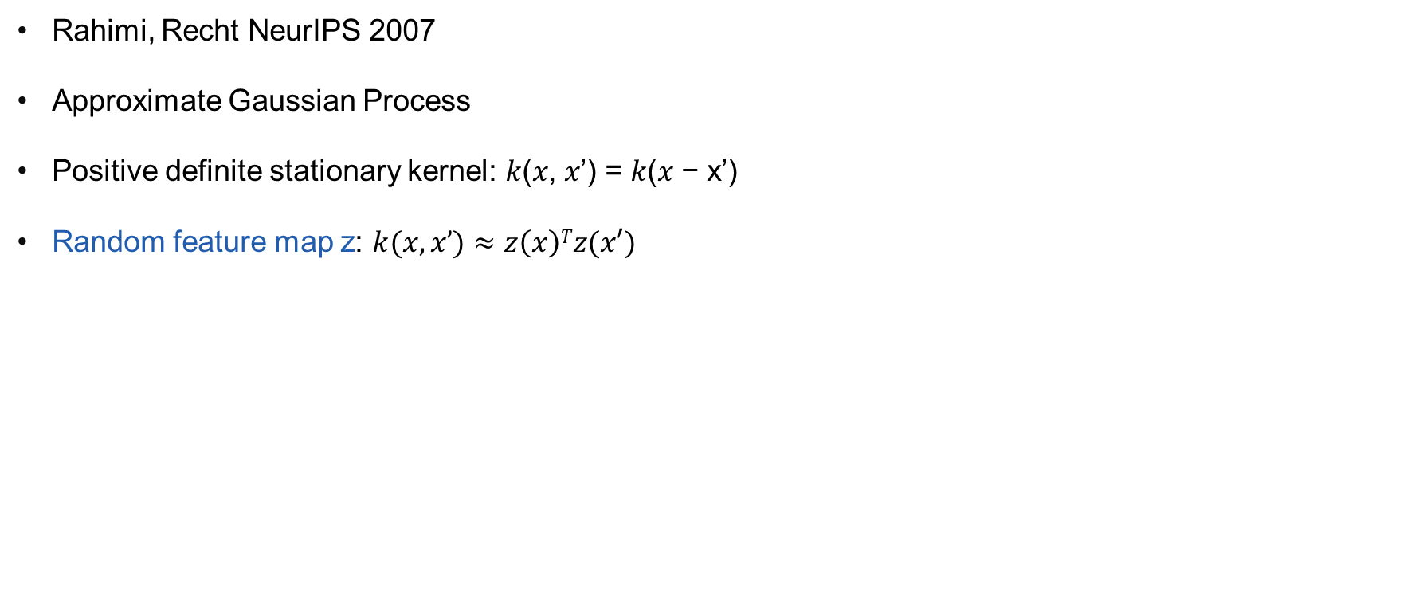
Random Fourier Features
Rahimi, Recht NeurIPS 2007
Approximate Gaussian Process
Positive definite stationary kernel: 𝑘(𝑥, 𝑥’) = 𝑘(𝑥 − x’)
Random feature map z: $k(x, x’)≈z\left(x\right)Tz(x′)$
Notes:
12
Each component of the feature map z(x) projects x onto a random direction ω drawn from the Fourier transform p(ω) of k(∆), and wraps this line onto the unit circle in R2
unbiased estimator of k(x, y).
Why project to circle: norms of the random vectors remain constant. the distance between the projected vectors (i.e., the angle between them) effectively approximates the distance between data points in the input space.

Slide 12
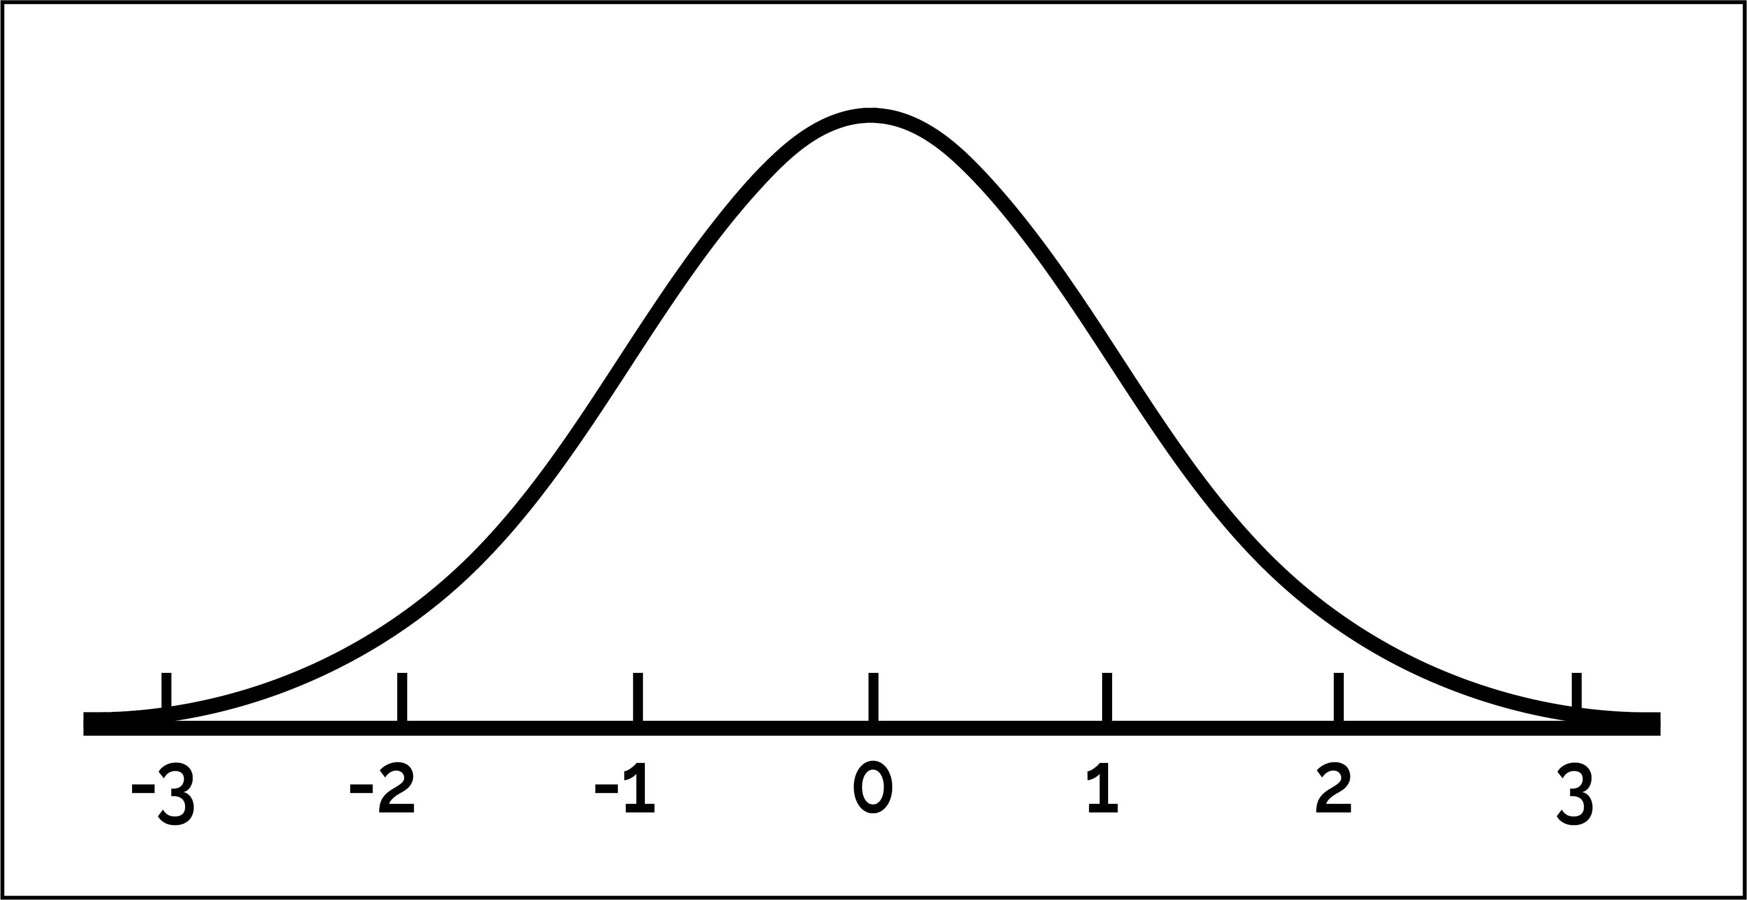
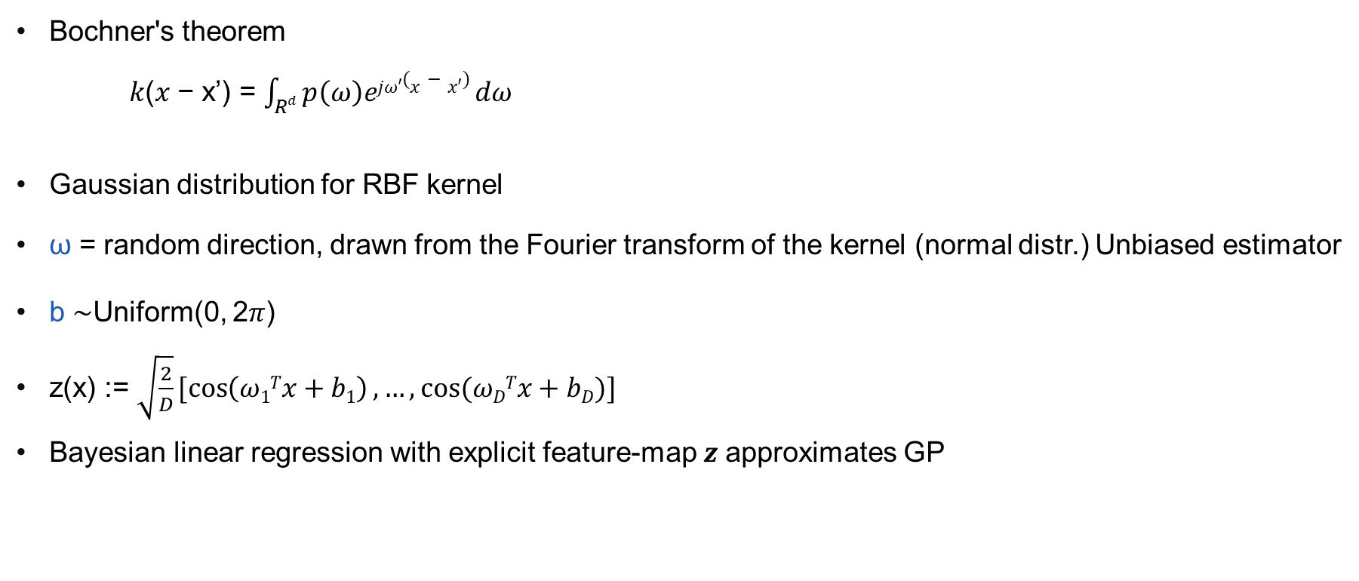
Random Fourier Features
Bochner's theorem
𝑘(𝑥 − x’) = $\int_{Rd}{p\left(ω\right)ejω′(x−x′) dω}$
Gaussian distribution for RBF kernel
ω = random direction, drawn from the Fourier transform of the kernel (normal distr.) Unbiased estimator
b ∼Uniform(0, 2𝜋)
z(x) := $\sqrt{\frac{2}{D}}[\cos\left(ω1Tx+b1\right), …,cos⁡(ωDTx+bD)]$
Bayesian linear regression with explicit feature-map 𝒛 approximates GP
Learnable
weights
NN output
Notes:
characterizes the Fourier transform of a positive finite Borel measure on the real line under Fourier transform a continuous positive-definite function on a locally compact abelian group corresponds to a finite positive measure on the Pontryagin dual group, kernel has corresponding probability measure
Each component of the feature map z(x) projects x onto a random direction ω drawn from the Fourier transform p(ω) of k(∆), and wraps this line onto the unit circle in R2
unbiased estimator of k(x, y).
Closed form for integral, does not depend on data,
Only need accurate representation for training (and test) points (inducing points)

Slide 13
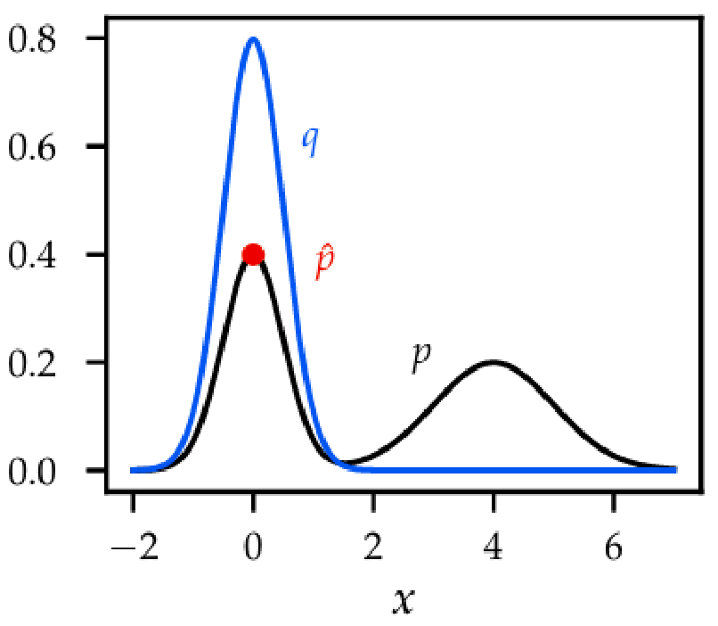
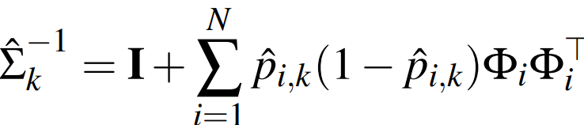
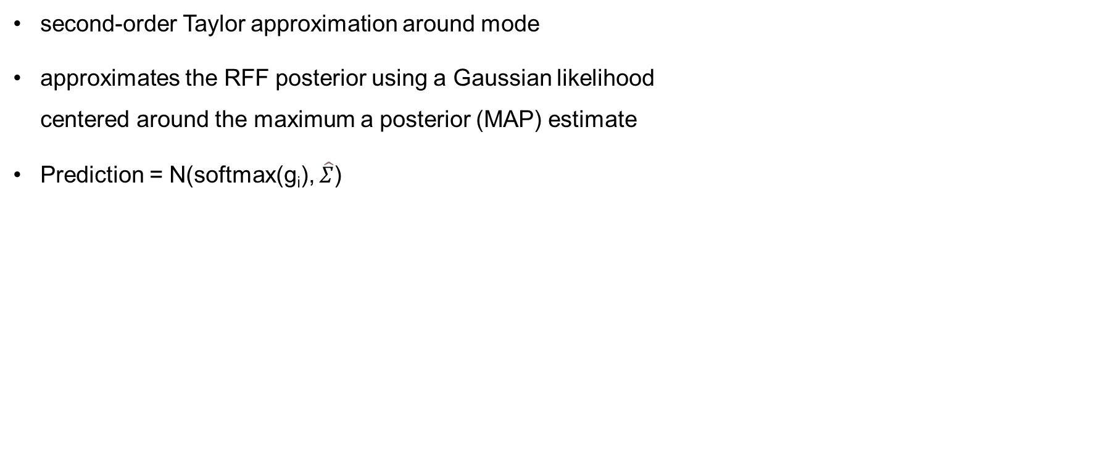
Laplace Approximation
second-order Taylor approximation around mode
approximates the RFF posterior using a Gaussian likelihood centered around the maximum a posterior (MAP) estimate
Prediction = N(softmax(g_{i}), $\hat{Σ}$)
BLR-output
RFF
Notes:
f (θ) ≈ ˆ f(θ) . = f(ˆ θ) + (θ− ˆ θ)⊤∇f(ˆ θ) + 1 2 = f(ˆ θ) + 1 2 (θ− ˆ θ)⊤Hf(ˆ θ)(θ− ˆ θ) (θ− ˆ θ)⊤Hf(ˆ θ)(θ− ˆ θ)

Slide 14
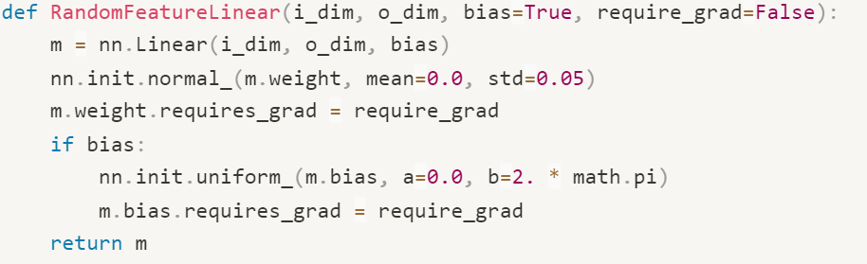
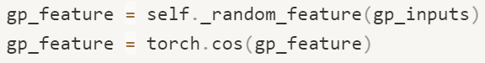
Random Fourier Features - Code
Notes:
Kernel is fixed!

Slide 15
We have an efficient Gaussian Process
Efficient GP as output layer
No need for a huge Gram matrix
Are we distance aware?
No!
Notes:
15 Are distance aware

Slide 16
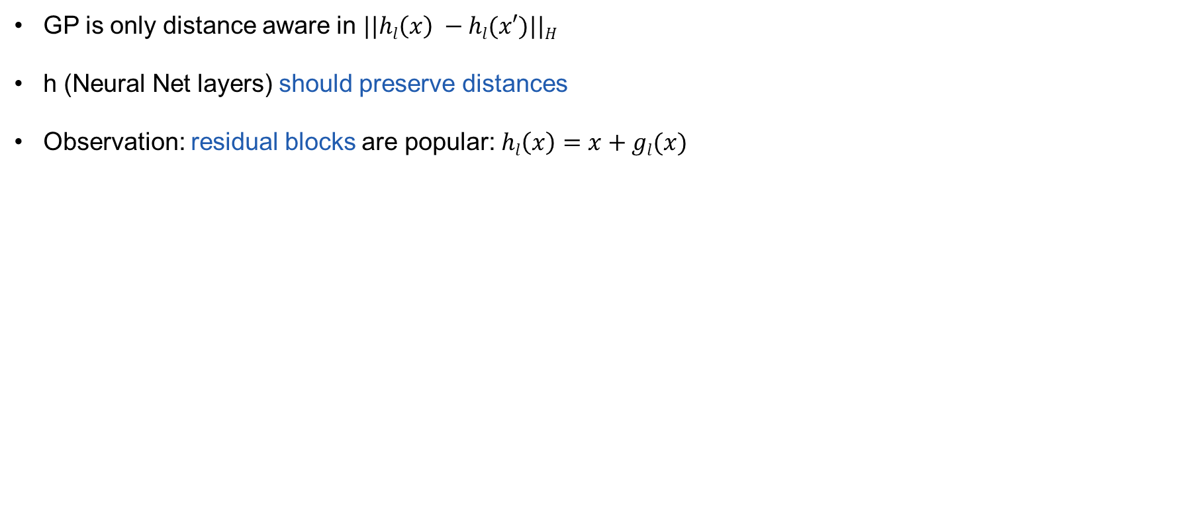
Distance-preserving Hidden Mapping via Spectral Normalization
GP is only distance aware in $||hl\left(x\right) −hl(x′)||H$
h (Neural Net layers) should preserve distances
Observation: residual blocks are popular: $hl\left(x\right)=x+gl(x)$

Slide 17
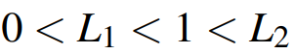
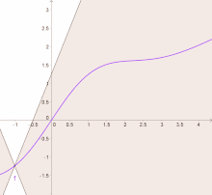
Bi-Lipschitz condition
= distance preserving
(adversarial robustness of a deep network)
Notes:
-> Small pertubations dont change output much

Slide 18
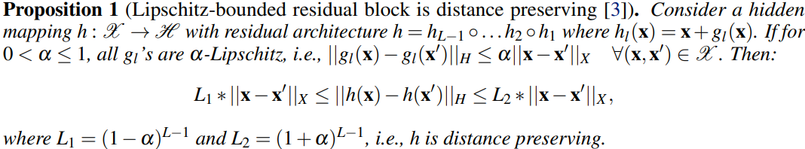
Distance-preserving Hidden Mapping via Spectral Normalization
Proof in the appendix

Slide 19
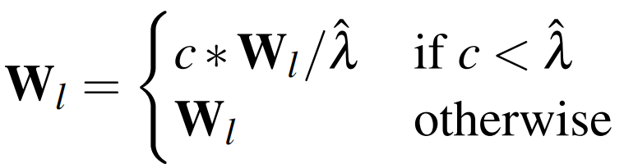
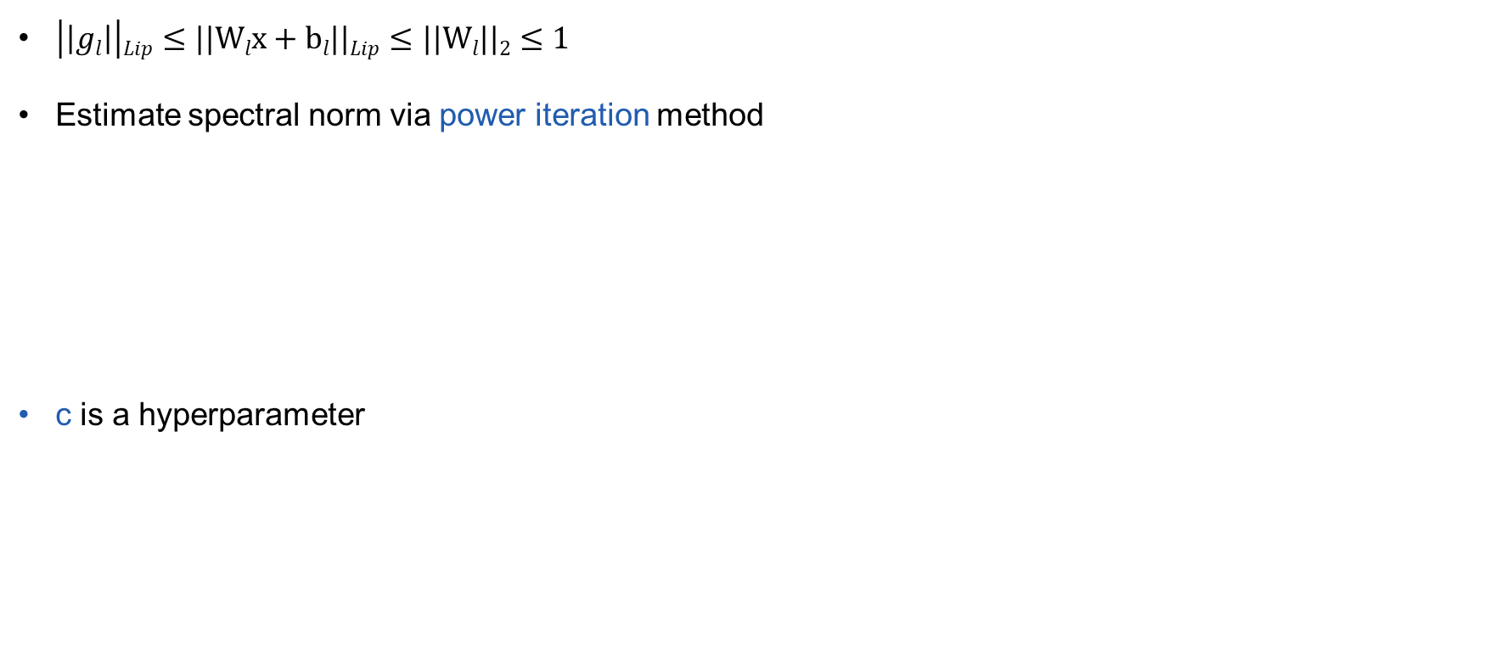
Distance-preserving Hidden Mapping via Spectral Normalization
largest eigenvalue
$\left|\left|gl\right|\right|Lip≤||Wlx+bl||Lip≤||Wl||2$ $≤1$
Estimate spectral norm via power iteration method
c is a hyperparameter
Notes:
19
L2 norm = max absolute eigenval
we find it is sufficient to fix power iteration to 1

Slide 20
SNGP
Efficient GP
Distance aware
Spectral normalized Neural network
Distance preserving
Spectral-normalized Neural Gaussian Process (SNGP)

Slide 21
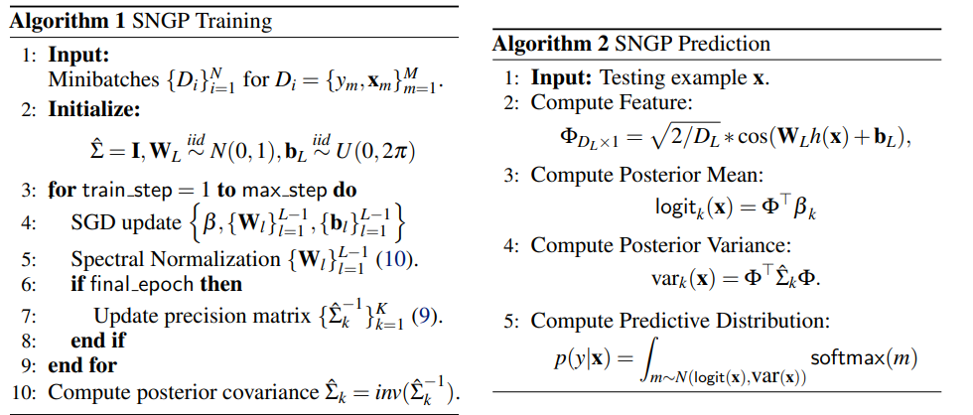
Algorithm

Slide 22
Experiments
Does it work?
Experiments
Toy example
Language (CLINC OOS)
Vision (CIFAR-10 and 100)
Notes:
21

Slide 23
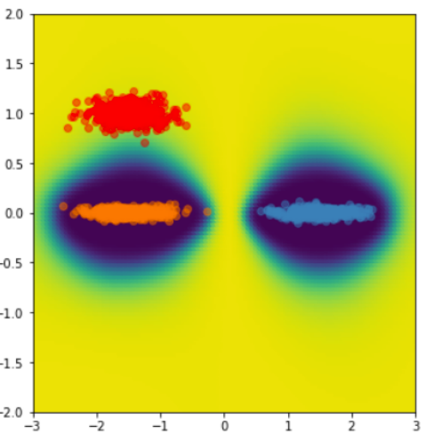
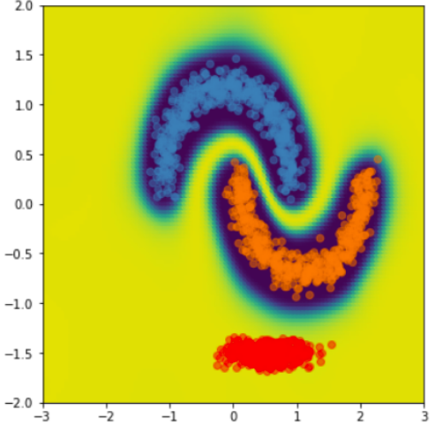

Experiments - Uncertainty Surface
Unseen
True
False
Notes:
GP ground truth
Blue = 0 = negative,
orange = 1 = positive
Red = not in training set

Slide 24
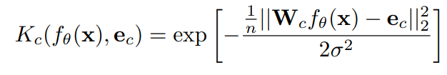
Experiments - Uncertainty Surface- Competitors
GP: target
Deep Ensemble: by Lakshminarayanan et al. 2016
Several NNs (usually same architecture) trained on different data-subsets
MC-Dropout: previous presentation
DNN-GP: GP, no spectral normalization
Extra:
Deterministic Uncertainty Quantification (DUQ)
RBF networks
Centroid (exp. Moving average)
One output weight matrix per class

Slide 25
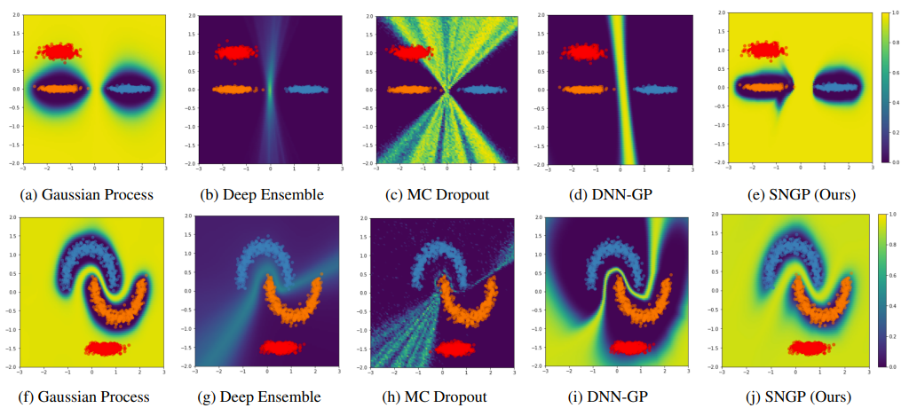
Experiments - Uncertainty Surface
Notes:
GP performs well in GP task?

Slide 26
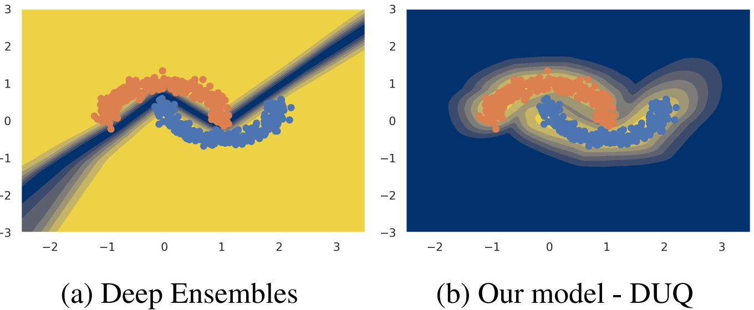
Experiments - Uncertainty Surface
Different colors used!
Notes:
Other methods can also do that

Slide 27

Experiments – CLINC OOS - Dataset
CLINC OOS intent detection benchmark dataset (English)
150 in-domain services with 150 training sentences in each domain,
1500 natural out-of-domain examples

Slide 28
Experiments – CLINC OOS
BERT backbone
Contestants
Same as before
MCD-GP
random Fourier features +MC Dropout

Slide 29
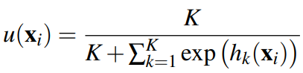
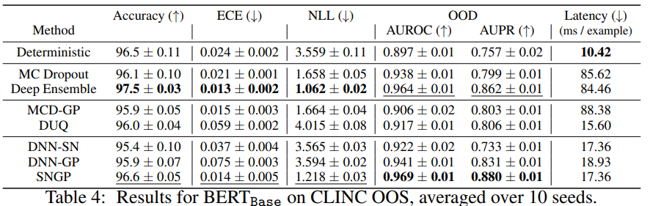
Experiments – CLINC OOS
Notes:
Dempster-Shafer metric, difference between two belief functions
K classes
We train the models only on in-domain data, and evaluate their predictive accuracy on the in-domain test data, their calibration and OOD detection performance on the combined in-domain and out-of-domain data

Slide 30
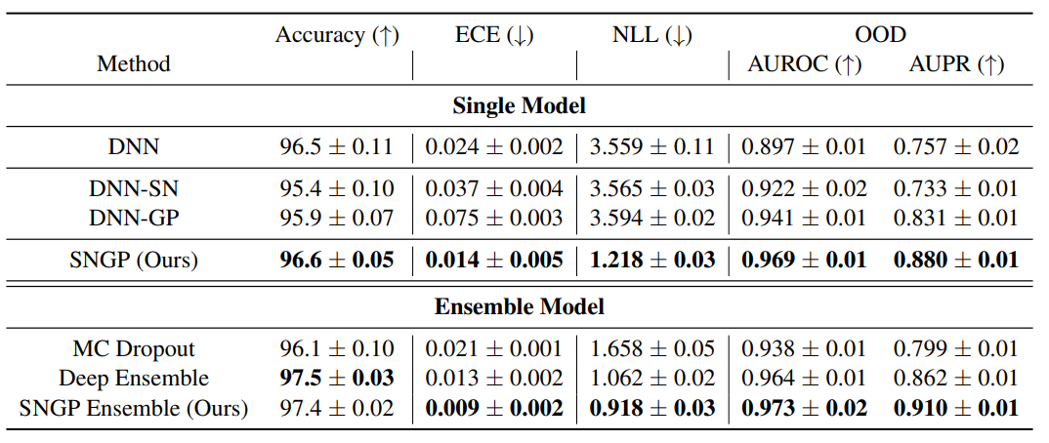
Extensions
Extended version of Paper
Ensemble
Notes:
Again language task

Slide 31
Extensions
heteroscedastic noise
HetSNGP
Fortuin (ETH affiliated) and Collier 2022
jointly modeling the model and data uncertainty
ensemble
Notes:
post-hoc temperature scaling.

Slide 32
Overview
Spectral-normalized Neural Gaussian Process (SNGP)
Distance aware Neural Network
Replace last layer with Gaussian Process
Faster than ensembles with comparable results
Training time might be high
Architecture specific
Old models
Ensembles are good
Notes:
Power iterations
Older models Usual uncertainty ppl

Slide 33
Thank you for your time!

Slide 34
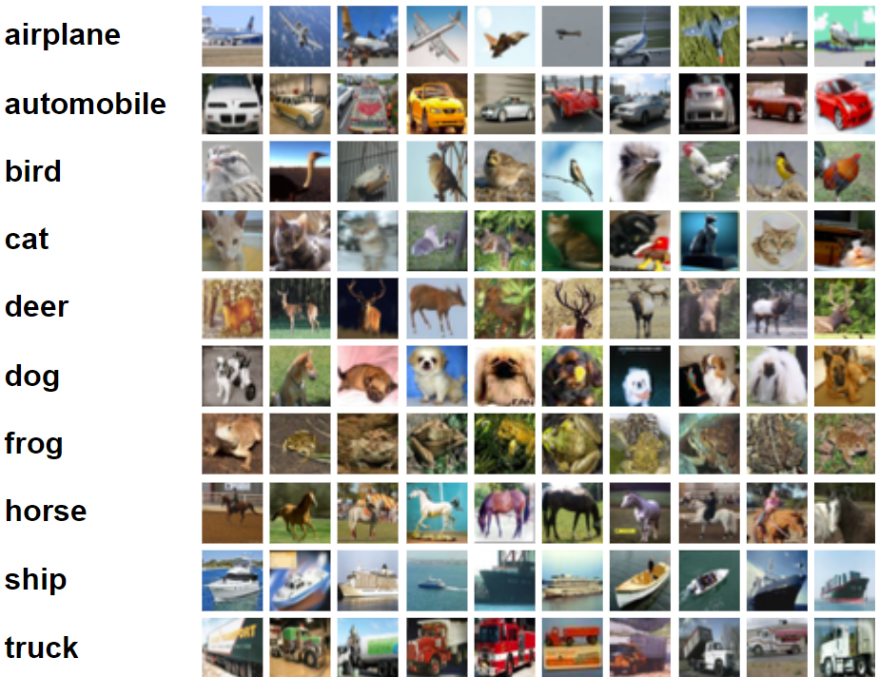
Experiments - CIFAR-10 and 100
One is training, other is OOD
SVHN as the OOD dataset for a model
trained on CIFAR-10/-100

Slide 35
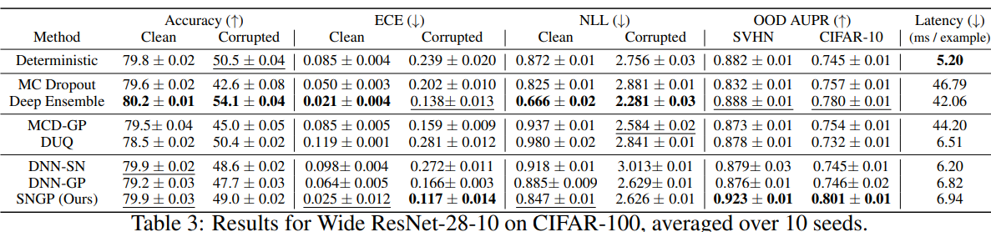
Experiments - CIFAR-100

Slide 36
Gaussian Process
Continuous stochastic process over domain X
{F(x) : x ∈ X}, each F(x) is a real-valued random variable
Gaussian process: for every finite set {x₁,...,x_{s}} ⊆ X
F(x₁),...,F(x_{s}) ∼ N, i.e. joint (multivariate) normality
Equivalently: every linear combination of {F(x₁),...,F(x_{s})} is a univariate normal

